Slide 1

PSYLIQ INTERNSHIP
DATA ANALYST

Slide 2

RECRUITMENT ANALYSIS

Slide 3
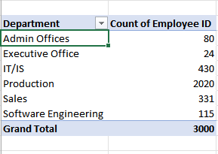
1. Can you create a pivot table to summarize the total number of employees in each department?

Slide 4
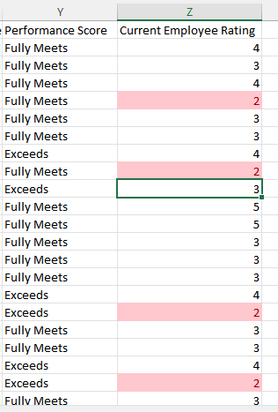
2. Apply conditional formatting to highlight employees with a "Performance Score" below 3 in red.

Slide 5
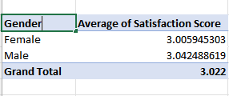
3. Calculate the average "Satisfaction Score" for male and female employees separately using a pivot table.

Slide 6
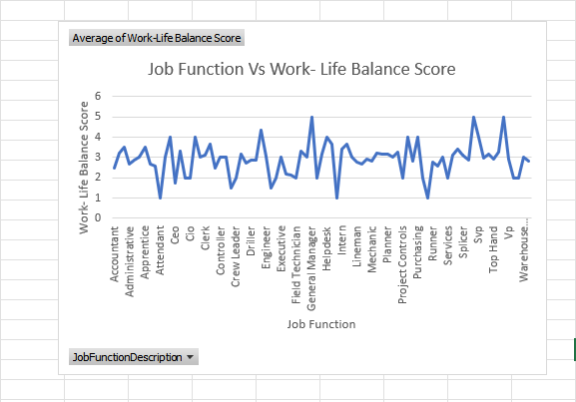
4. Create a chart to visualize the distribution of "Work-Life Balance Score" for different job functions.

Slide 7
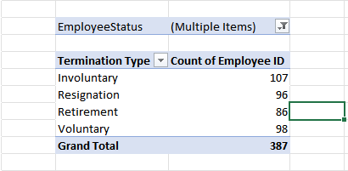
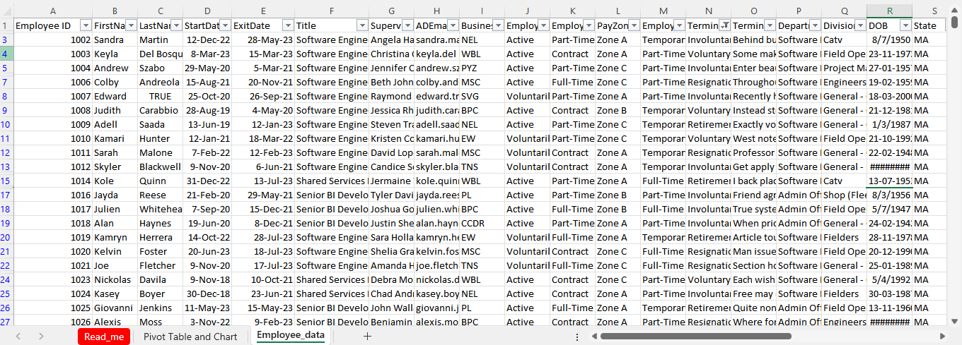
5. Filter the data to display only terminated employees and find out the most common "Termination Type."
Involuntary Termination is the most common termination type.

Slide 8
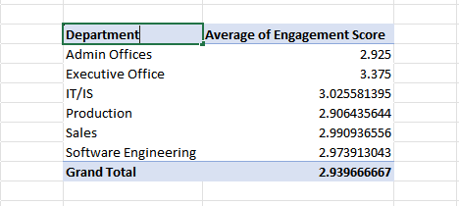
6. Calculate the average "Engagement Score" for each department using a pivot table.

Slide 9
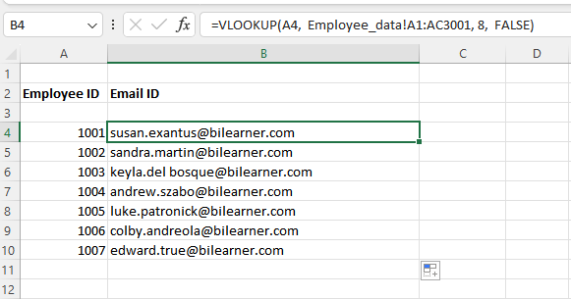
7. USE VLOOKUP TO FIND THE SUPERVISOR'S EMAIL ADDRESS FOR A SPECIFIC EMPLOYEE.

Slide 10
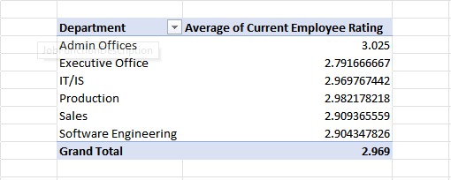
8. Can you identify the department with the highest average "Employee Rating?"

Slide 11
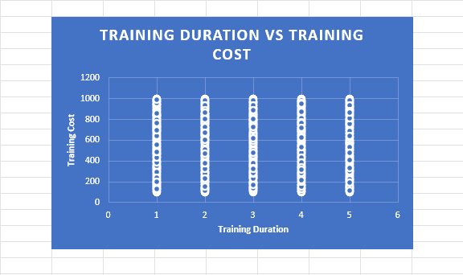
9. Create a scatter plot to explore the relationship between "Training Duration (Days)" and "Training Cost."

Slide 12
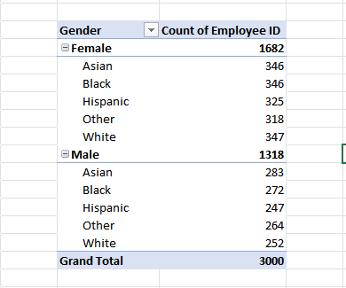
10. Build a pivot table that shows the count of employees by "RaceDesc" and "GenderCode."

Slide 13
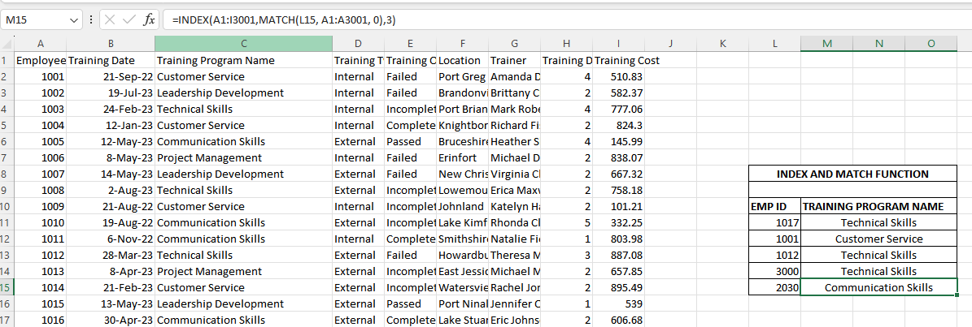
11. Use INDEX and MATCH functions to find the "Training Program Name" for an employee with a specific ID.

Slide 14
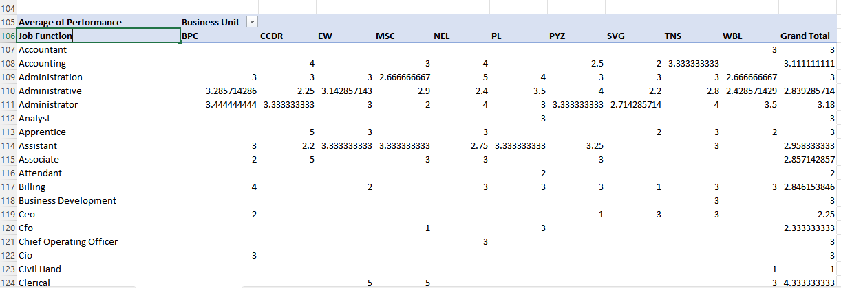
12. Create a multi-level pivot table to analyze the "Performance Score" by "BusinessUnit" and "JobFunctionDescription."

Slide 15
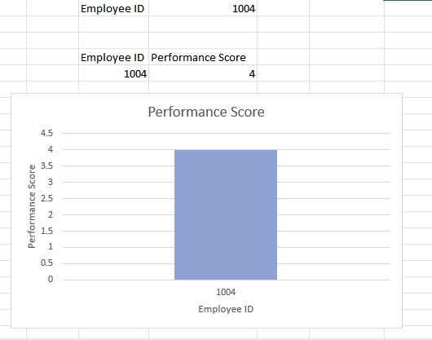
13. Design a dynamic chart that allows users to select and visualize the performance of any employee over time.

Slide 16
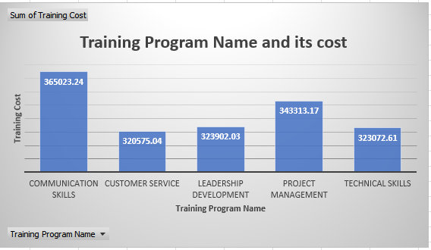
14. Calculate the total training cost for each "Training Program Name" and display it in a bar chart.

Slide 17
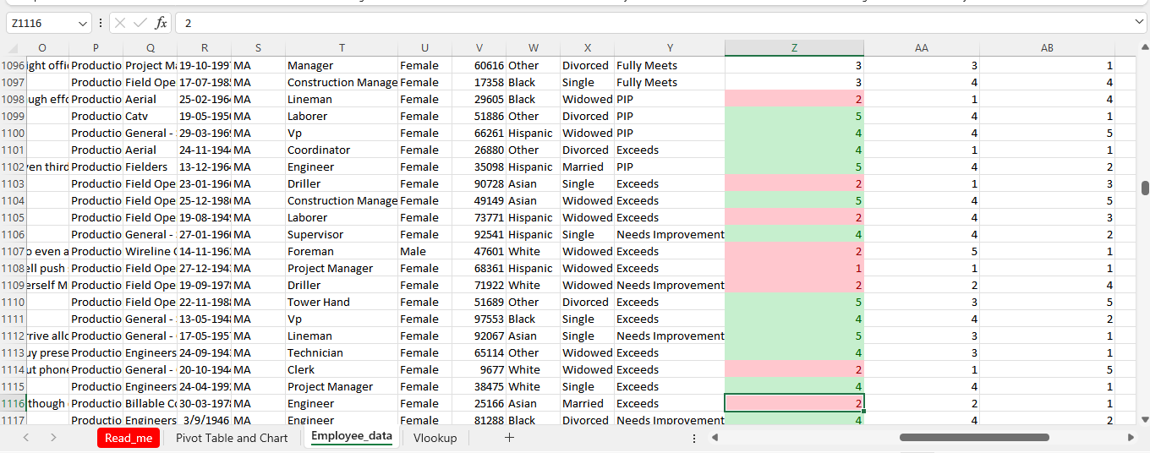
15. Apply advanced conditional formatting to highlight the top 10% and bottom 10% of employees based on "Current Employee Rating."

Slide 18
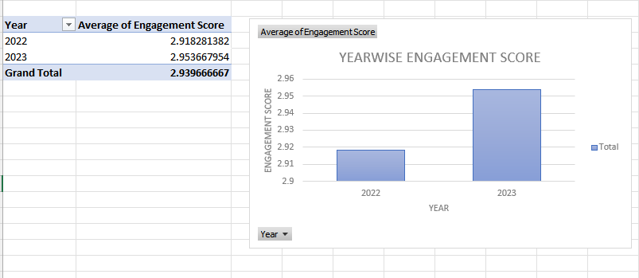
16. Use a calculated field in a pivot table to determine the average "Engagement Score" per year.

Slide 19
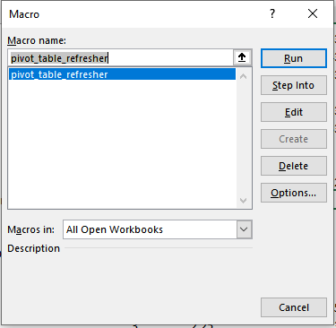
17. Can you build a macro that automates the process of updating and refreshing all pivot tables in the workbook?

Slide 20
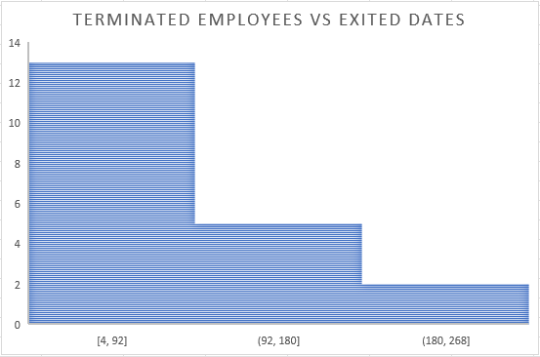
18. Create a histogram to understand the distribution of "ExitDate" for terminated employees.

Slide 21
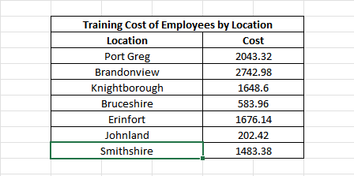
19. Utilize the SUMPRODUCT function to calculate the total training cost for employees in a specific location.

Slide 22
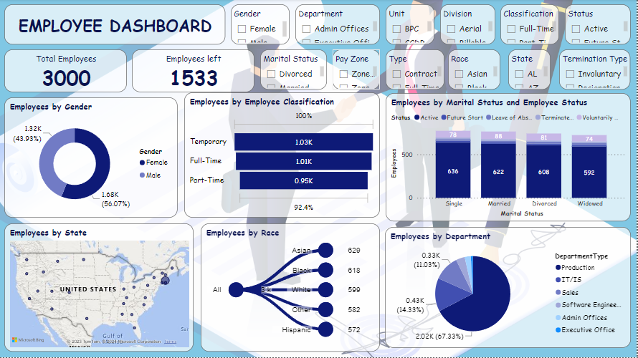
20. Develop a dashboard that provides an overview of key HR metrics, including headcount, performance, and training costs, using charts and pivot tables.

Slide 23
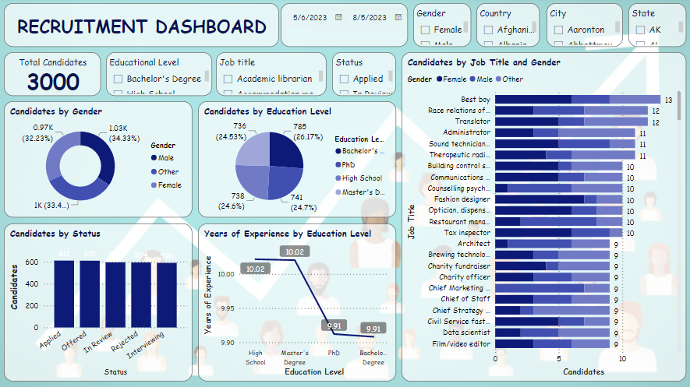

Slide 24
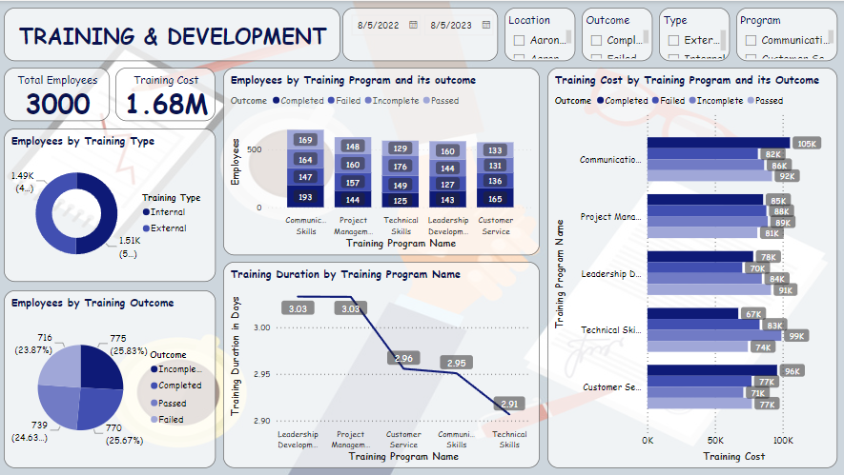

Slide 25
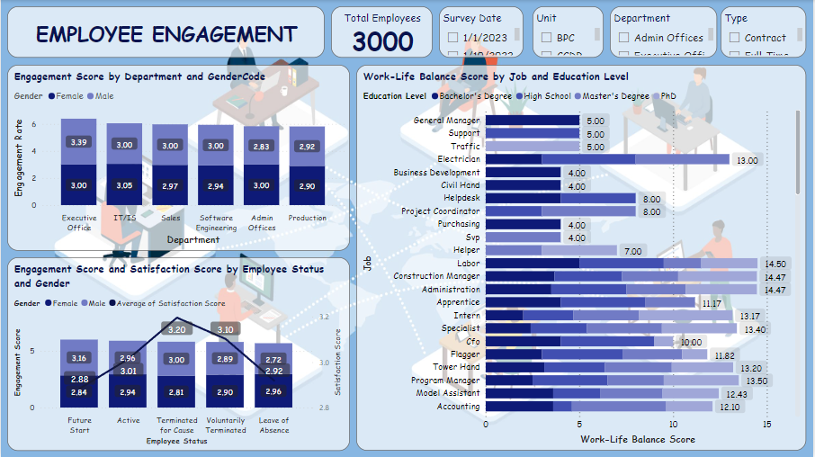

Slide 26

THANK YOU

